Slide 1

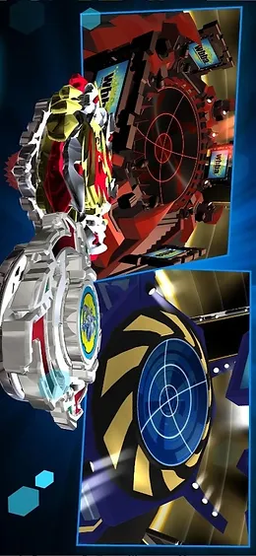
BEYBLADE AR GAME

Slide 2
OUR TEAM
Ahmet Faruk İLOĞLU
Ayşe ÖZTAN
Doğa DÜZGÖL
Egemen CENGİZ
Erce ALTUN

Slide 3
CONTENTS
PROJECT DEFINITION
FEATURES
WORK PLAN
METHODS & TECHNOLOGIES
EXPECTED OUTPUTS
DEMO
POTENTIAL RISKS
SIMILAR PROJECTS
QUESTIONS

Slide 4
PROJECT DEFINITION
In our project, it is aimed to develop the strategic Beyblade game played on the arena, which we place on a 3D virtual plane integrated into the real world. Our project can be played both in single and multiplayer. In the single-player game, the difficulty of the game can be adjusted so that the artificial intelligence will fight the user accordingly.

Slide 5
FEATURES
Single-player Mode: In the single-player game, the difficulty of the game can be adjusted so that the artificial intelligence will fight the user accordingly. The AI ​​will use damage against the user according to the user's skill usage or at his own will.
Multiplayer Mode: In multiplayer, players will be able to join the same lobby and play against each other.

Slide 6
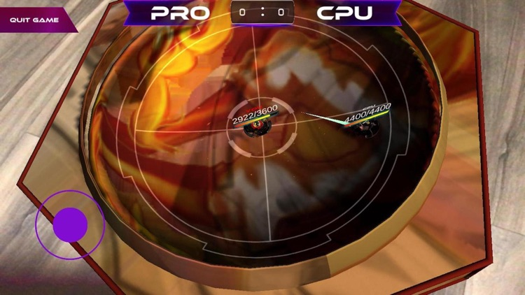
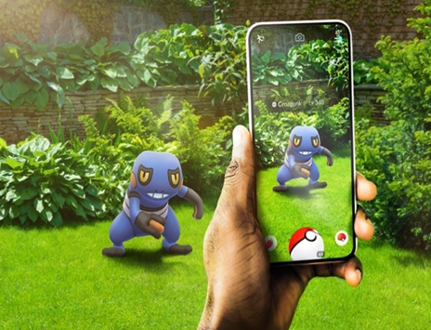
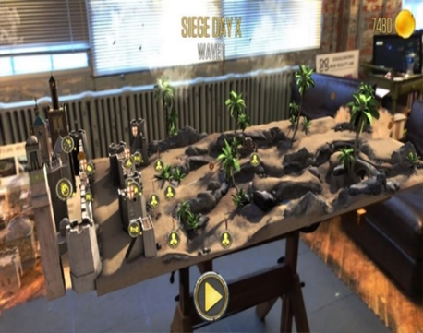
SIMILAR PROJECTS

Slide 7
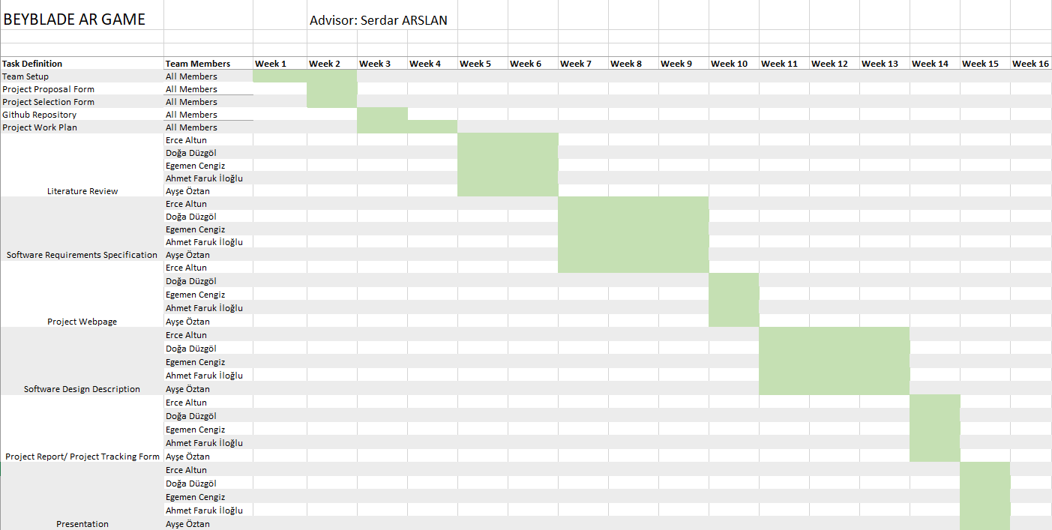
WORK PLAN

Slide 8



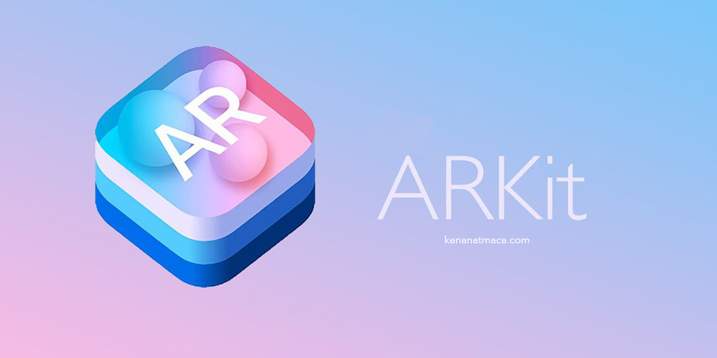

METHODS & TECHNOLOGIES

Slide 9
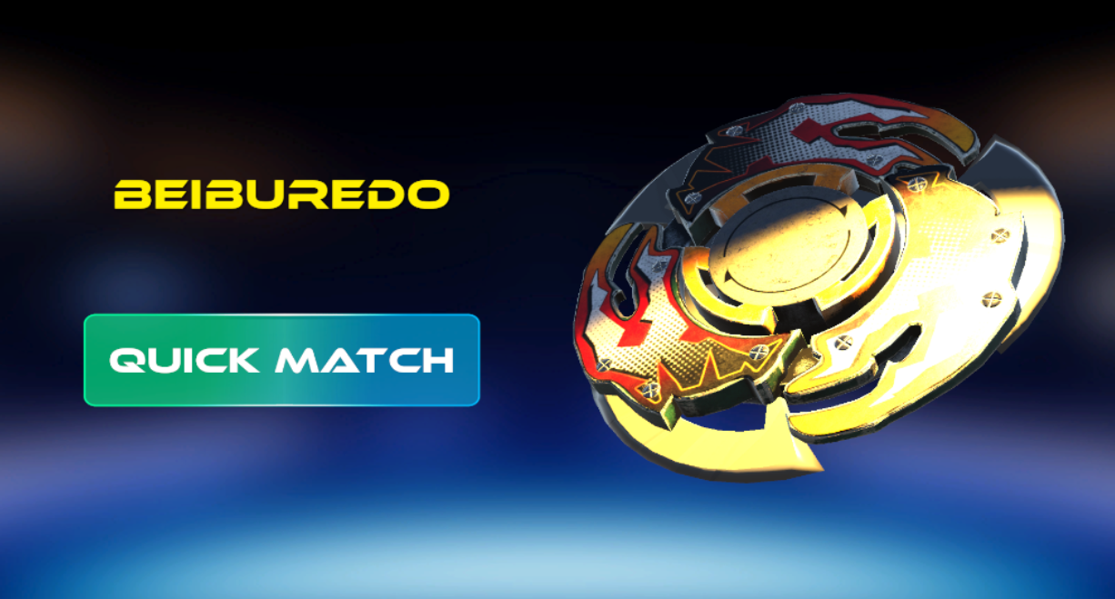

Slide 10
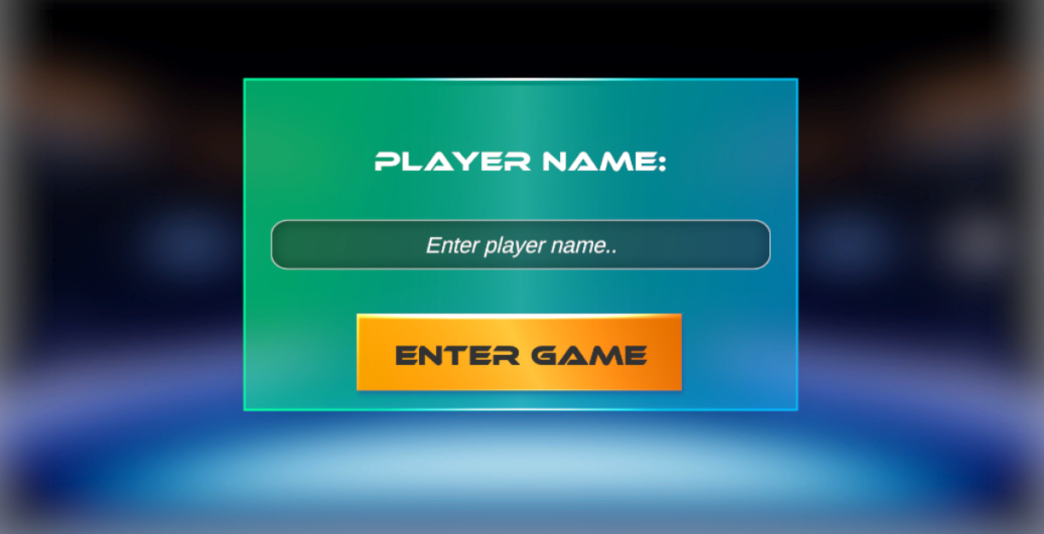

Slide 11
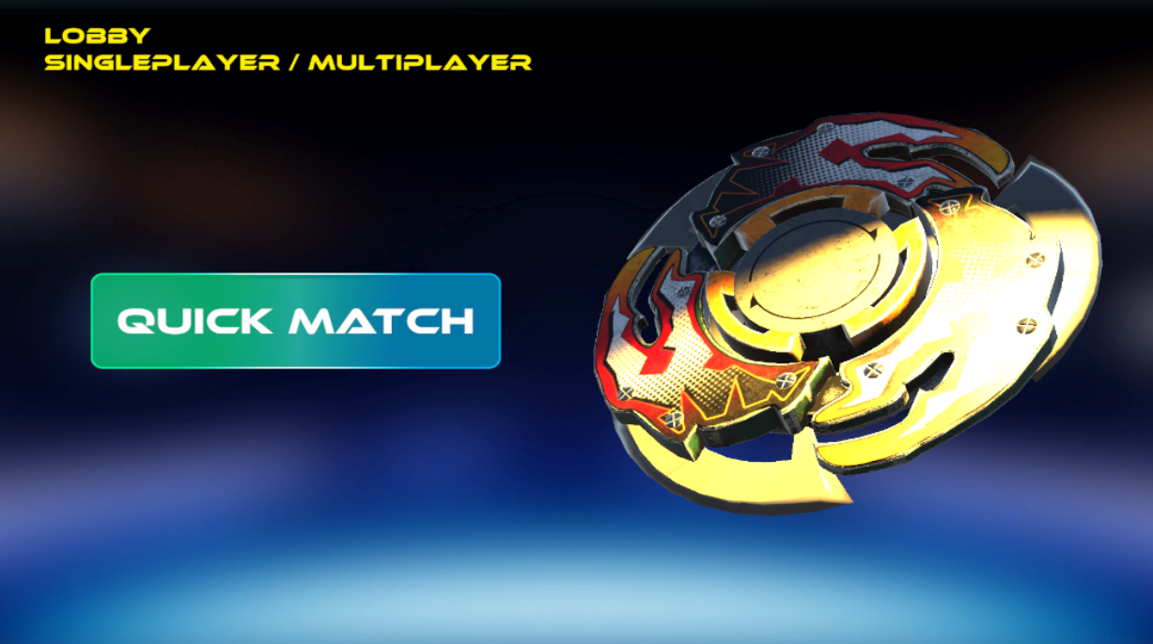

Slide 12


Slide 13
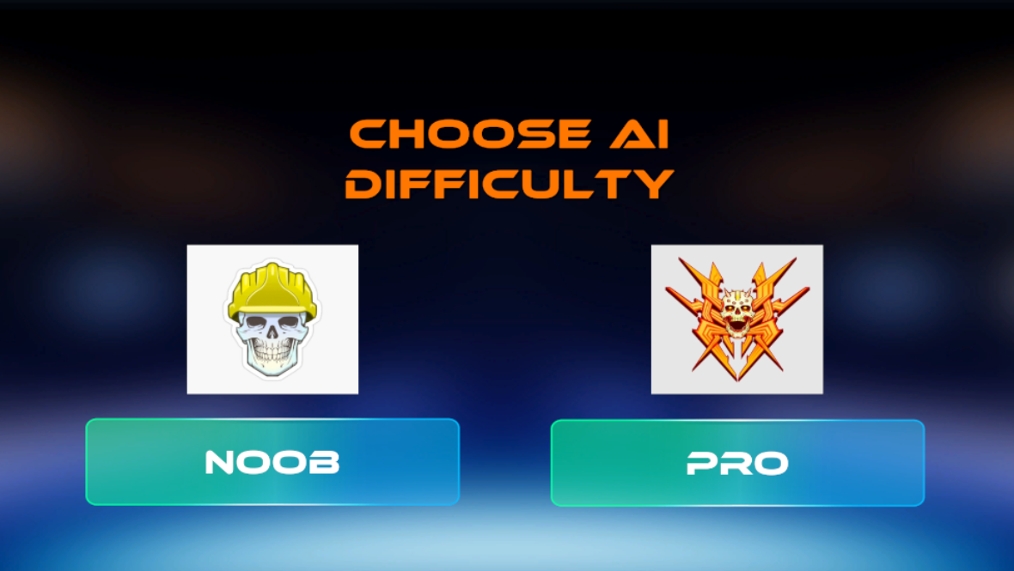

Slide 14
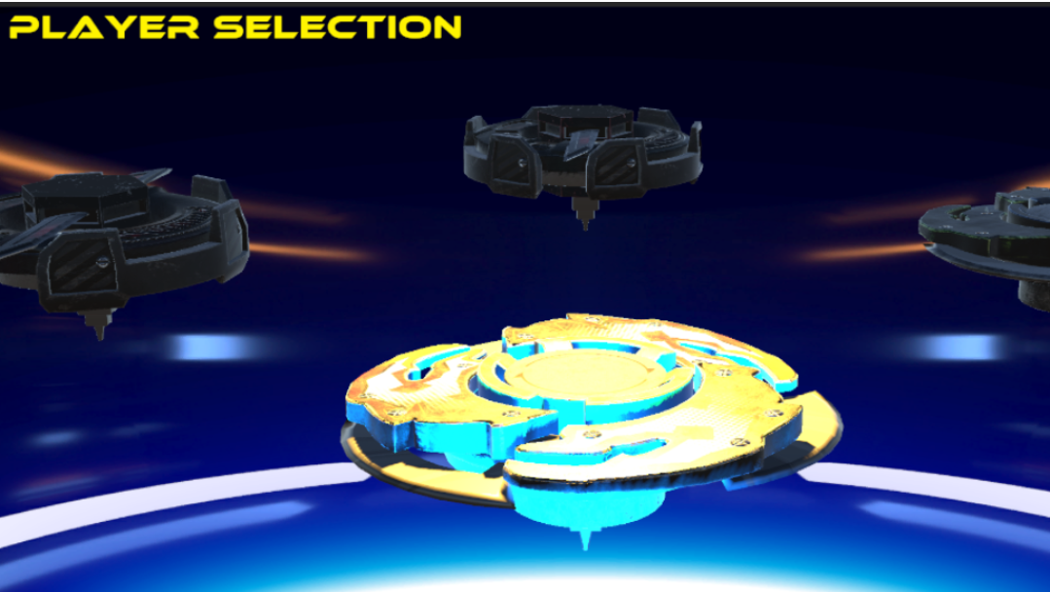

Slide 15
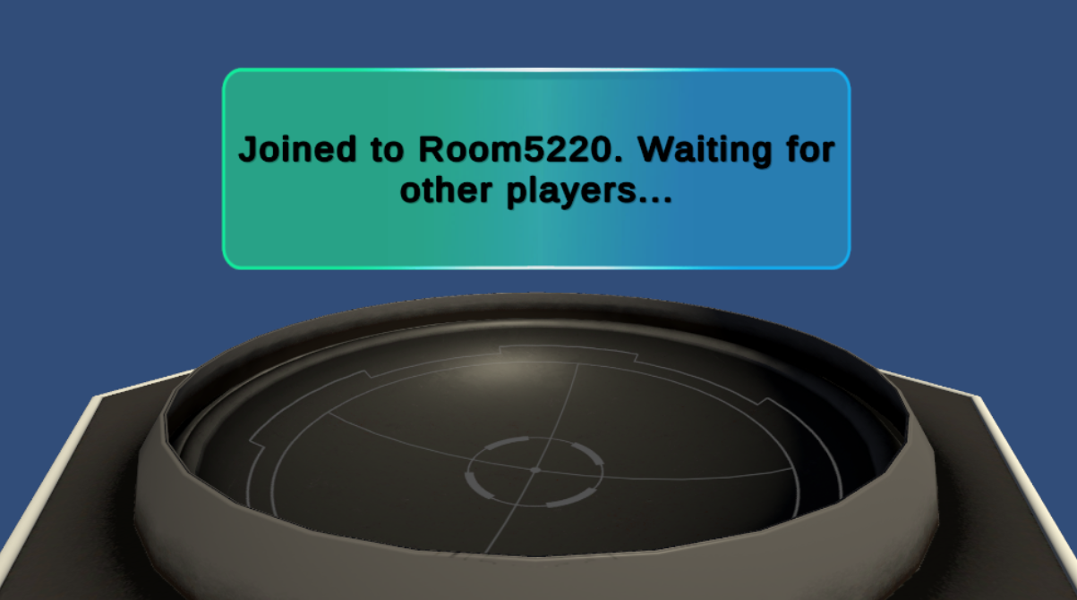

Slide 16
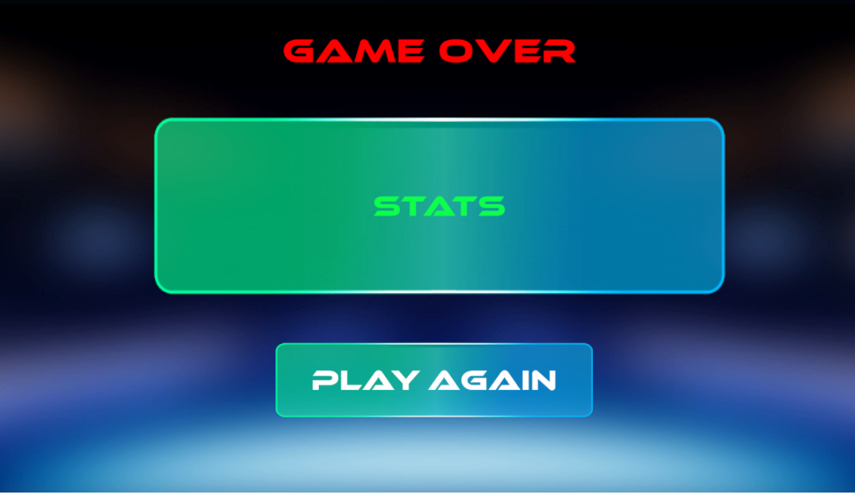

Slide 17
DEMO https://youtu.be/pncGklmAa1U

Slide 18
POTENTIAL RISKS
When creating an augmented reality environment on mobile, problems arise if the user's phone does not meet the system requirements.
The disadvantage of the multiplayer mode is that, unlike the single player mode, there is network latency.

Slide 19
QUESTIONS ?

Slide 20
THANK YOU FOR LISTENING! ☺

